Slide 1
Management system for: Academy of the handsome men and beautiful woman(BEA) web application
author: Kristina Shiryagina
supervisor: Prof. Dr Olivier Biberstein

Slide 2
Introduction
This project is a part of the application BEA.
BEA is an online academy that offers different courses
Beauty course
Beauty instructor course
Future courses

Slide 3
Outline
Project Vision
Project Organization
Phase Analysis
Phase Design
Phase Implementation
Testing
Conclusion and future work

Slide 4
Vision

Slide 5
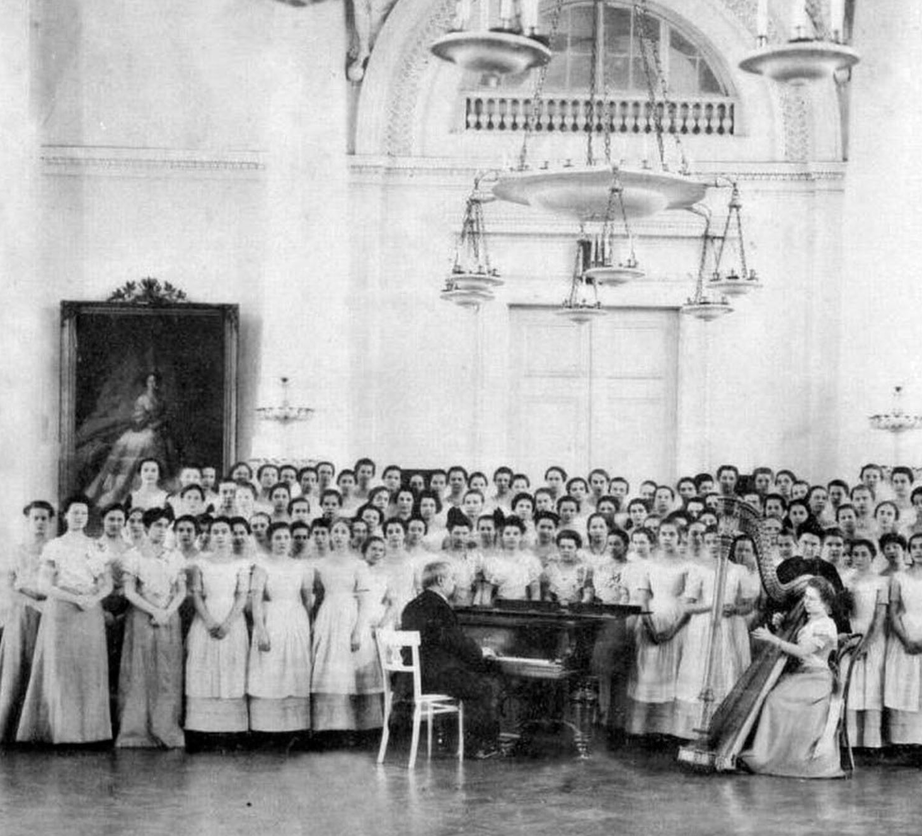
Chorus of pupils of the Smolny Institute. Graduation Album of 1889

Slide 6
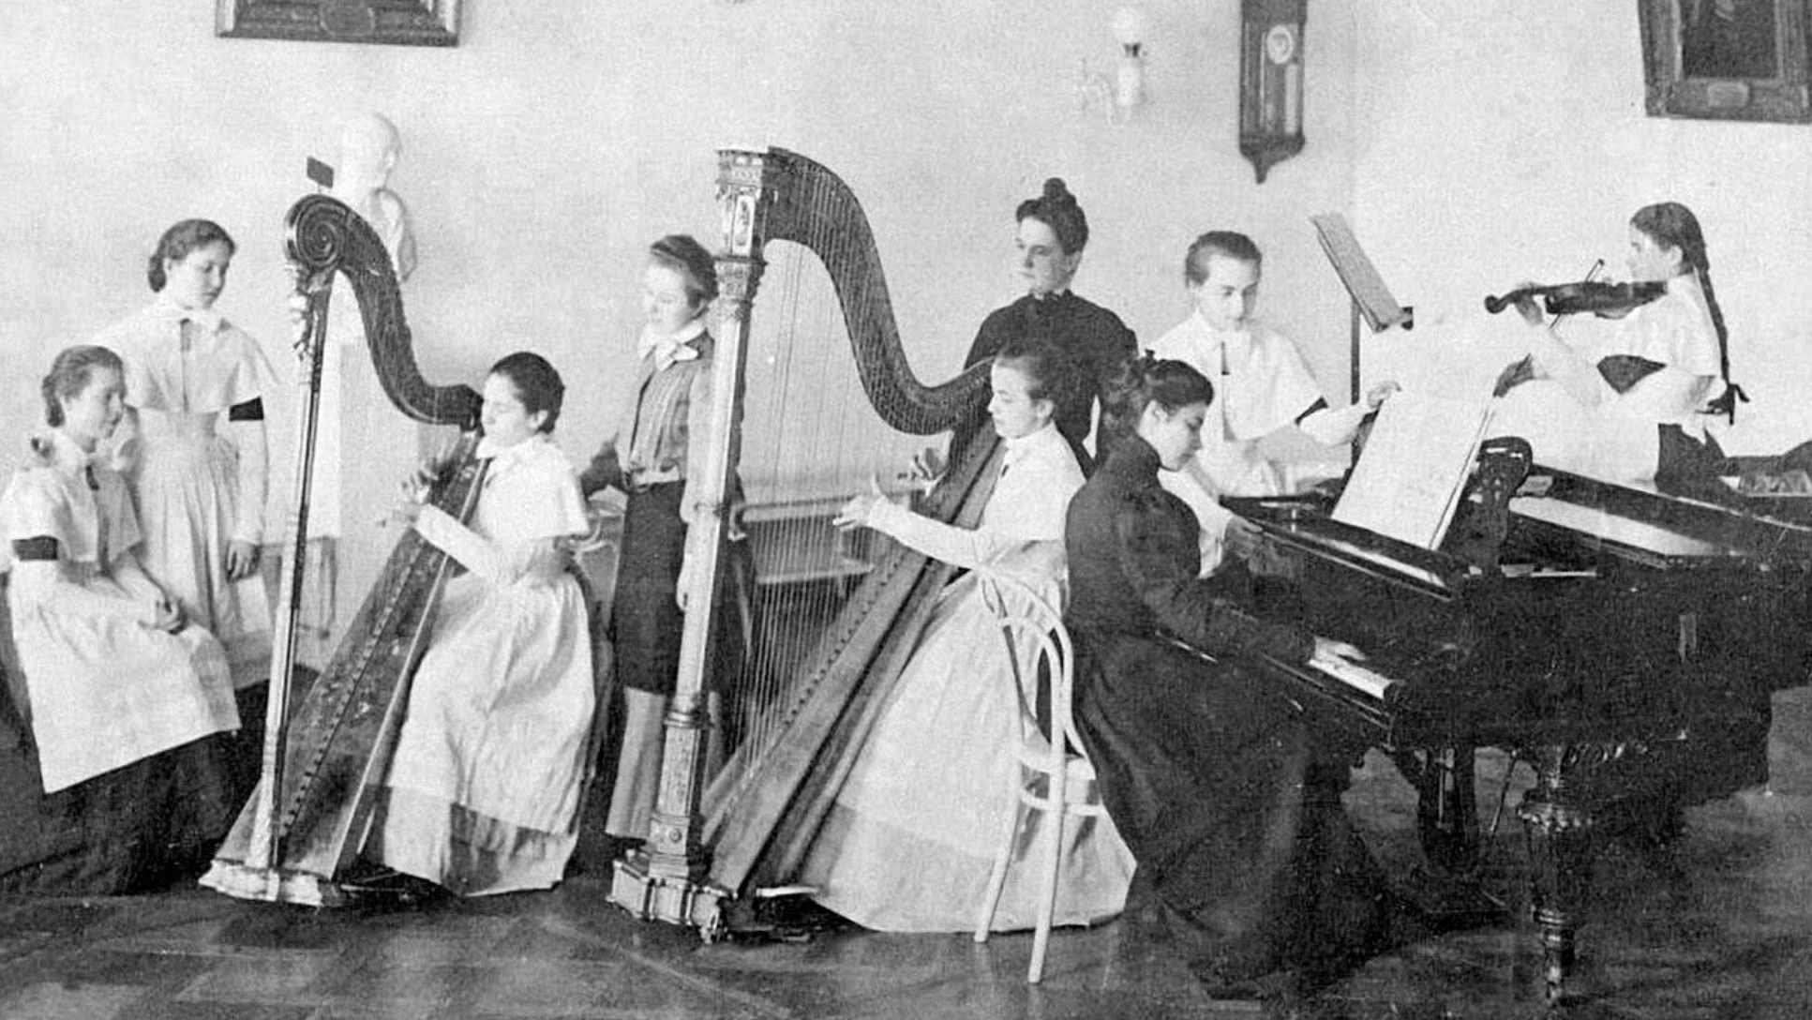
Lessons of music

Slide 7
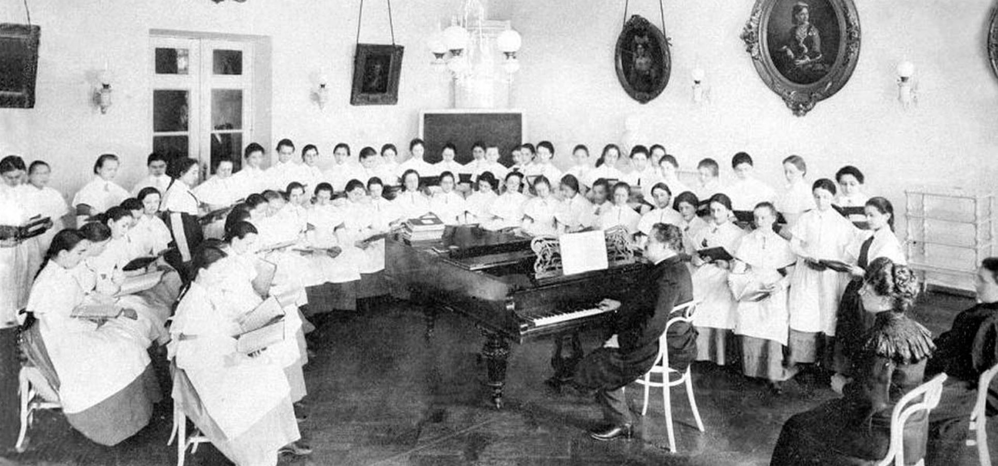
Lessons of singing

Slide 8
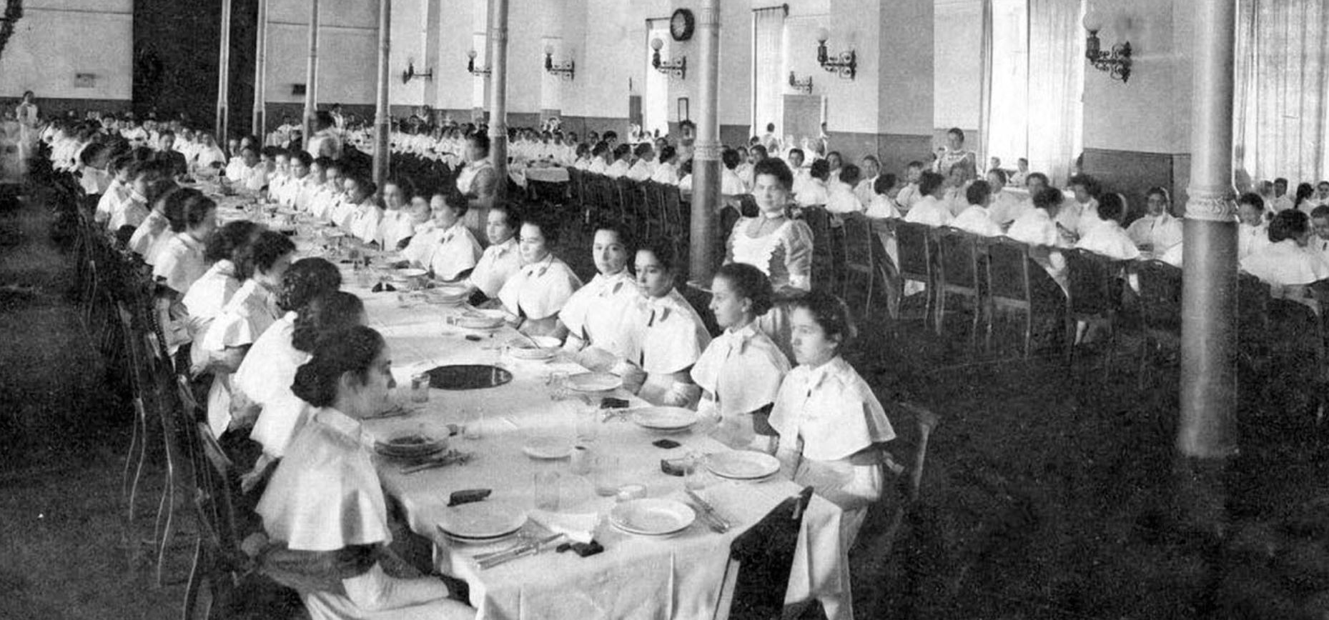
Canteen

Slide 9
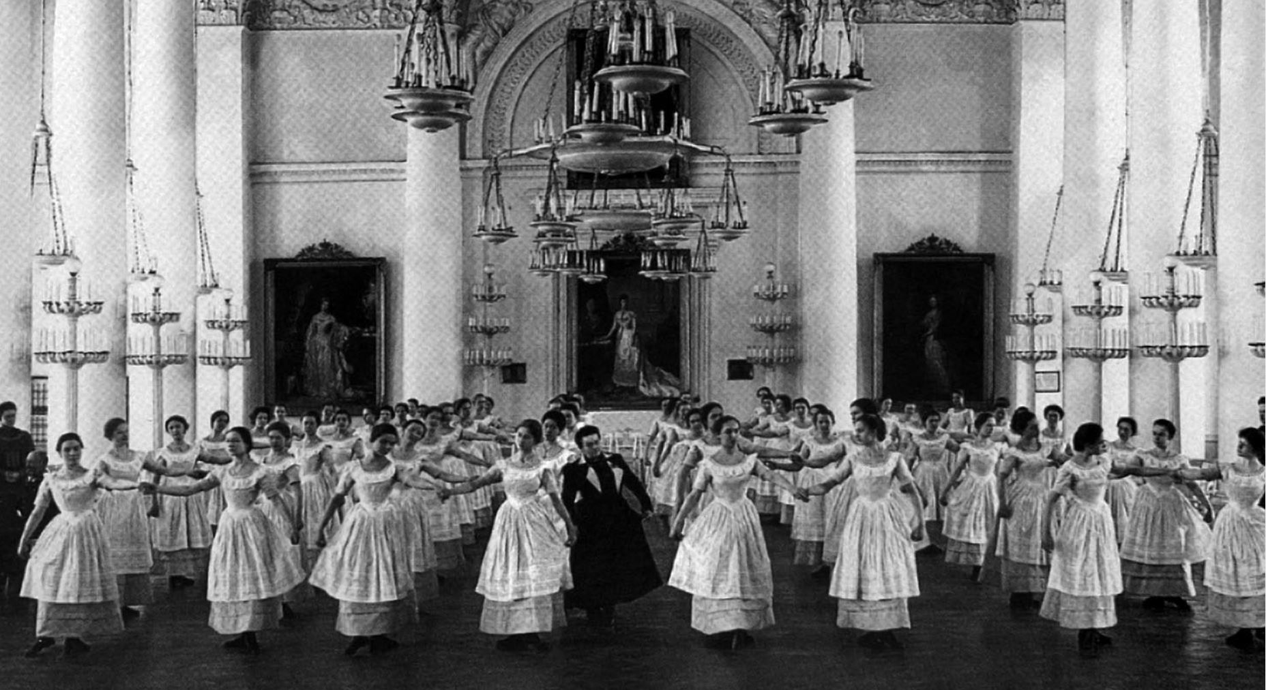
dancing

Slide 10
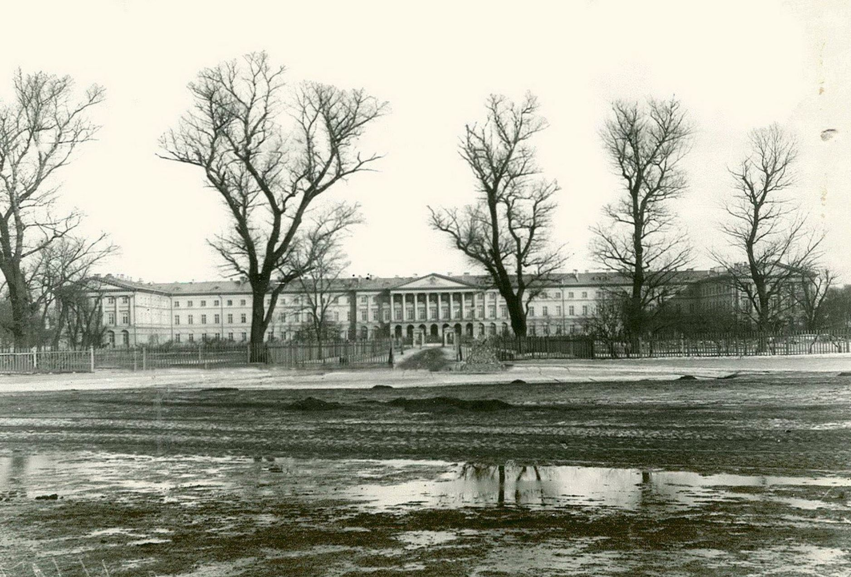
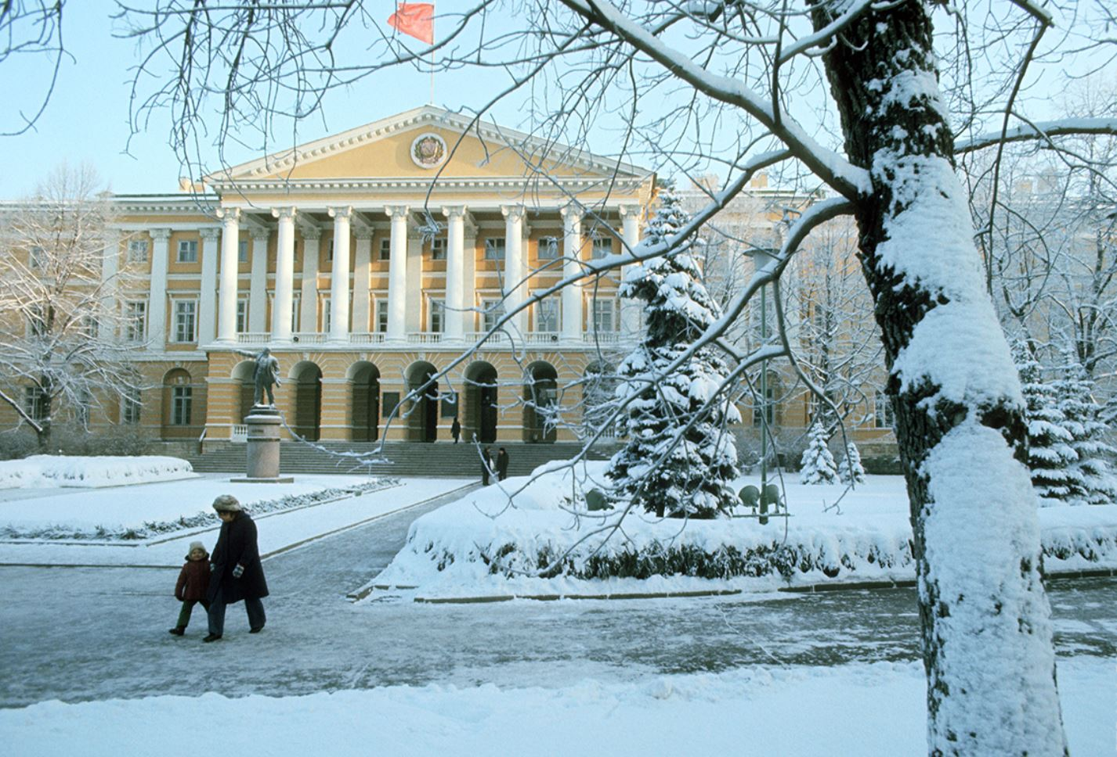
Smolensk Institute Saint Petersburg

Slide 11
First steps of my work

Slide 12
User page

Slide 13
Use case for user and participant

Slide 14
Use case for administrator and lecturer

Slide 15
Domain model

Slide 16
Summary of System Features
• Online registration.
• Log in.
• Manage User information.
• Manage Offering Courses.
• Course registration.
• Exam registration (order an exam).

Slide 17
Design

Slide 18
CRUD METHODS FOR ADMIN
CREATE AND UPDATE

Slide 19
Sd for CRUD METHODS FOR ADMIN
Process add course

Slide 20
Sd for order an exam

Slide 21
Implementation
Spring Boot + Angular

Slide 22
Test an application
JUNIT
CHECKLIST
POSTMAN
DATABASE TESTING
SECURITY TESTING
USABILITY TEST

Slide 23
Summary and future work
System analysis and design System Implementation Database Spring boot and angular connection Concept classes Features Login Registration Admin tools Course registration (partially) Order registration (partially) System testing(partially)

Slide 24
Outlook
Microservices
The goal of future work is to build a number of smaller microservices.
Microservices offer faster development cycles and have better scaling.

